Slide 1
Achievements: Functionality
What we completed in Sprint 1
Completed backlog items
User registration and login prototype
Scooter list display
Booking workflow prototype
Payment workflow prototype
Customer pages and admin pages
Database schema and backend API structure

Slide 2
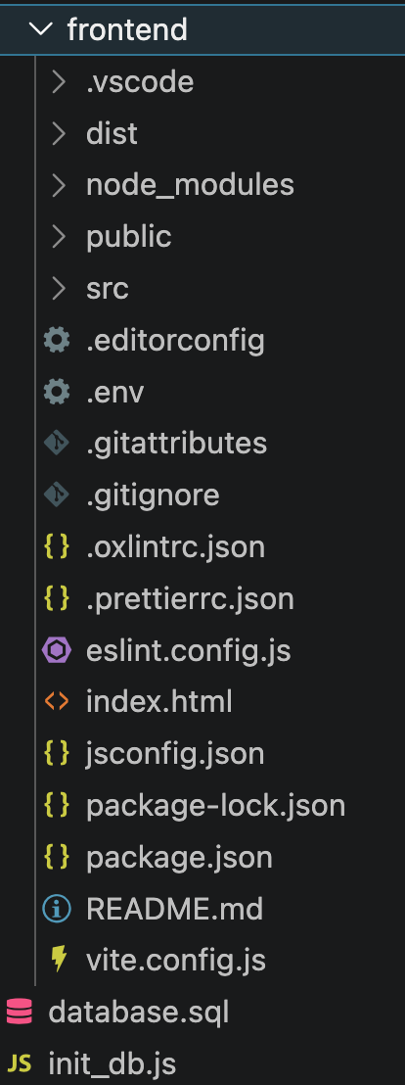
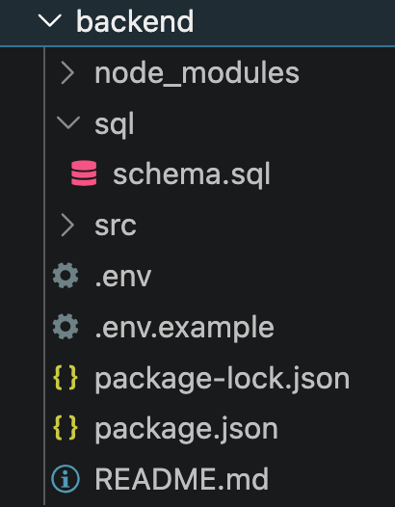
Achievements: System and Code
Current implementation progress
Technical progress
Frontend built with Vue, Vite, Pinia, and Router
Core customer and admin views are in place
Backend built with Express and MySQL
Auth, scooters, bookings, and payment routes created
Database schema covers users, scooters, bookings, and payments

Slide 3
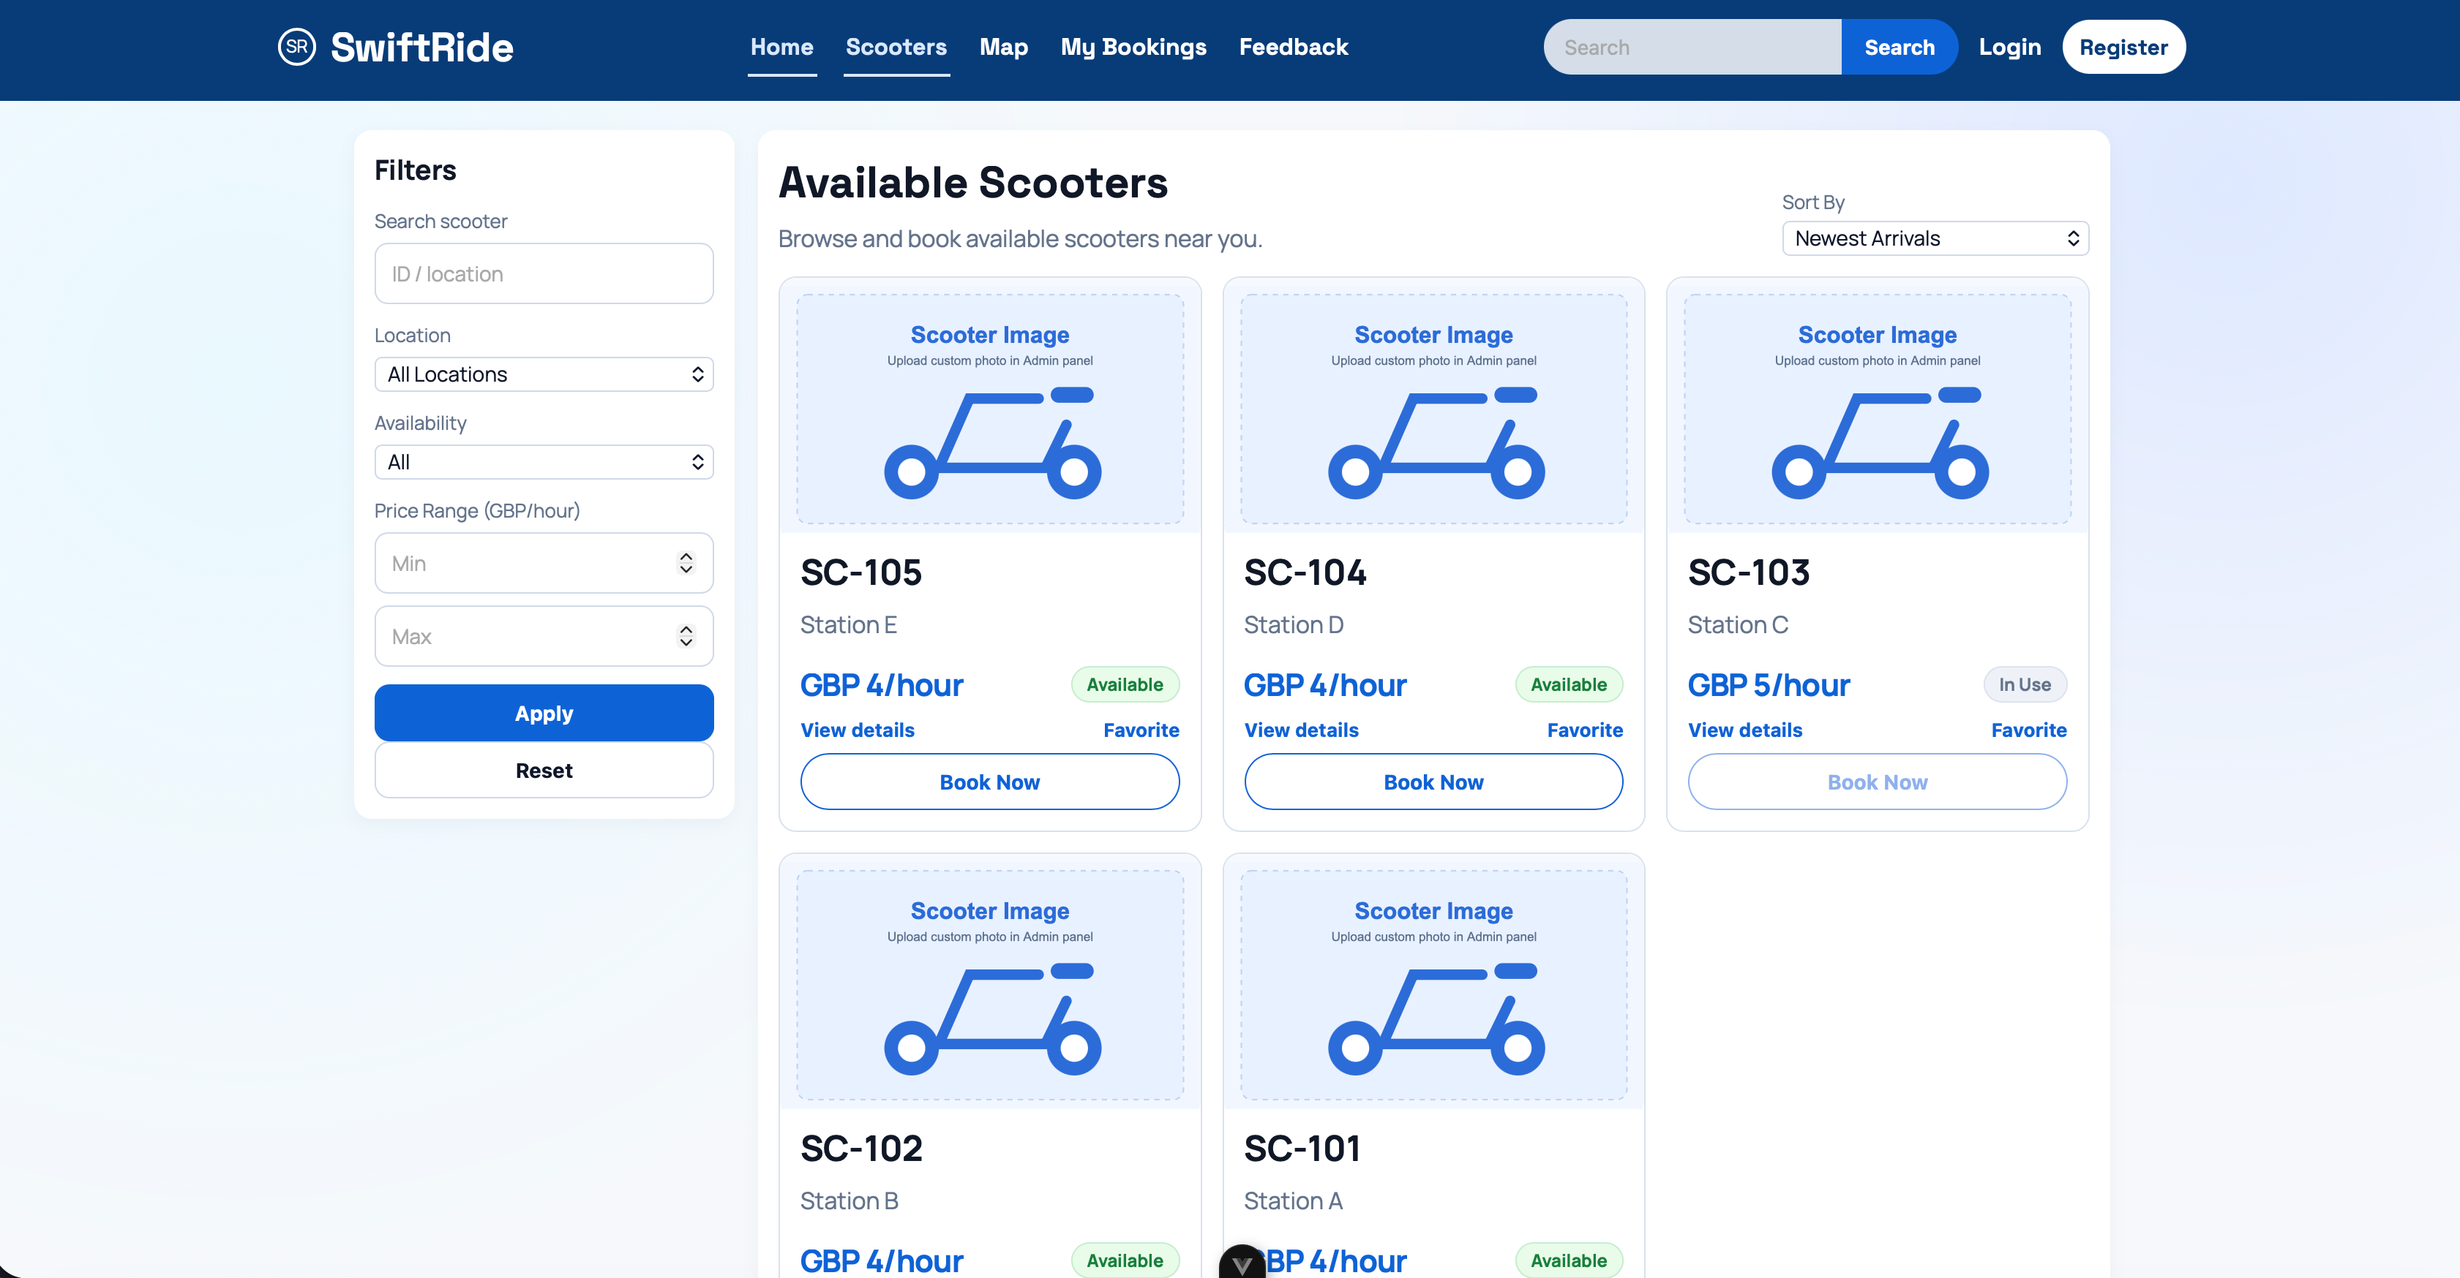
Customer Interface Example
This screenshot shows part of the customer-side workflow.

Slide 4
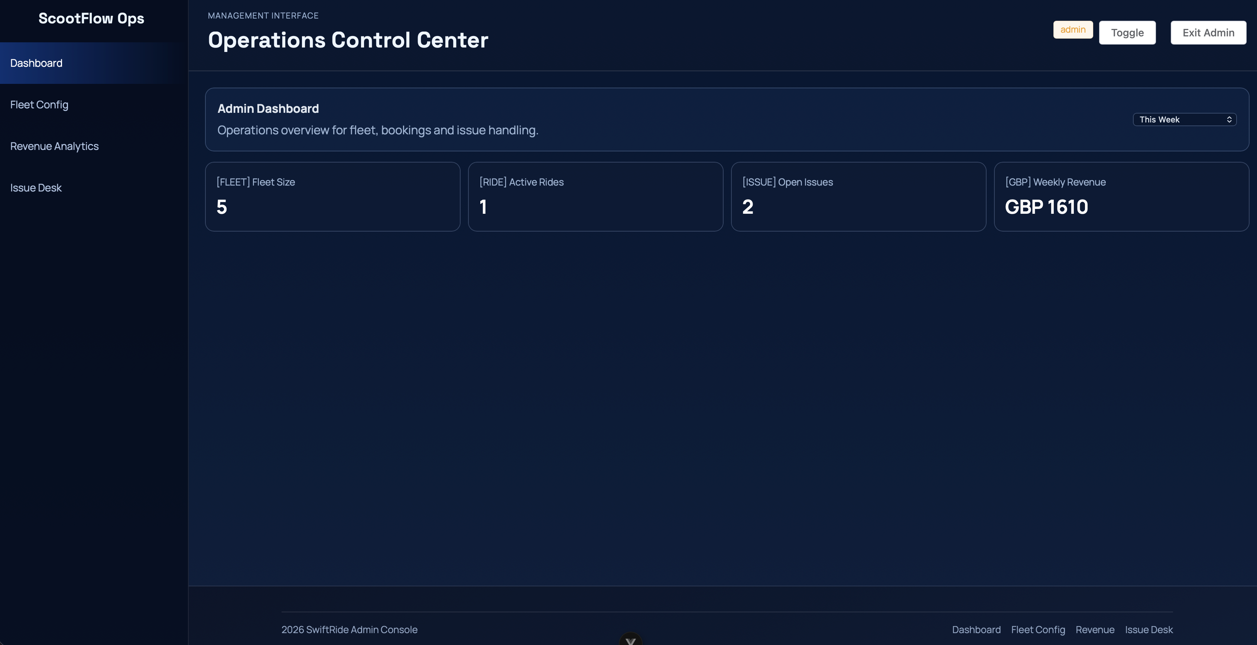
Admin Interface Example
This screenshot shows part of the management-side interface.

Slide 5
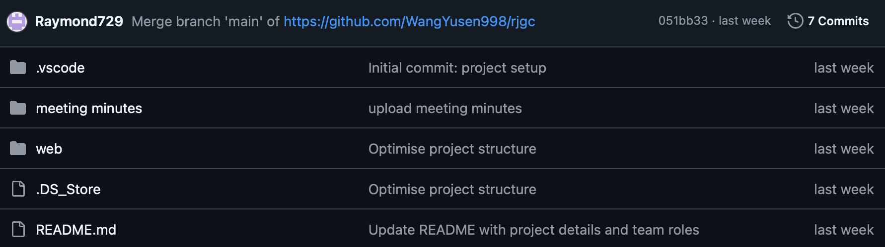
Process
How the team organized work and recorded Sprint 1 progress
Process and records
Used Git and GitHub for shared development
Split work across frontend, backend, and design tasks
Held meetings to discuss requirements and architecture
Recorded progress, diagrams, and sprint materials
Used evidence such as backlog items, notes, or issue tracking

Slide 6
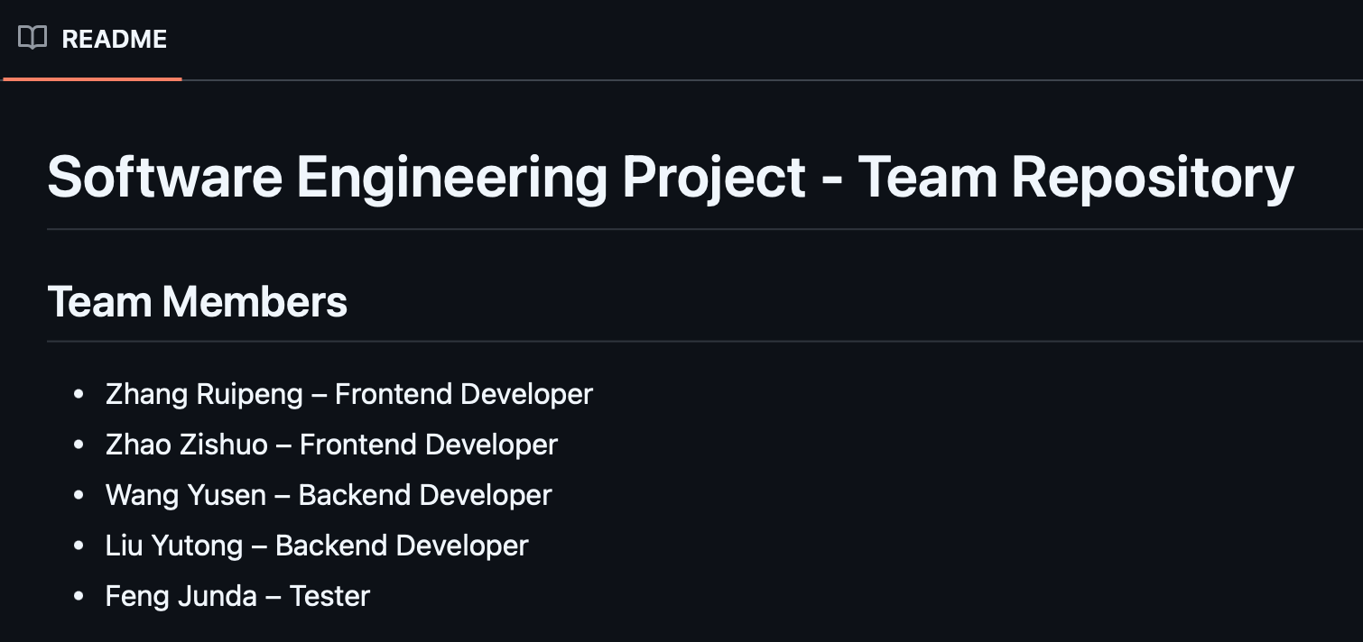
Team Management
How the team handled communication, decisions, and sprint priorities
Management focus in Sprint 1
Maintained communication through WeChat group
Made technical decisions together
Focused on architecture before advanced features
Managed time by keeping Sprint 1 scope realistic
Identified technical gaps early

Slide 7
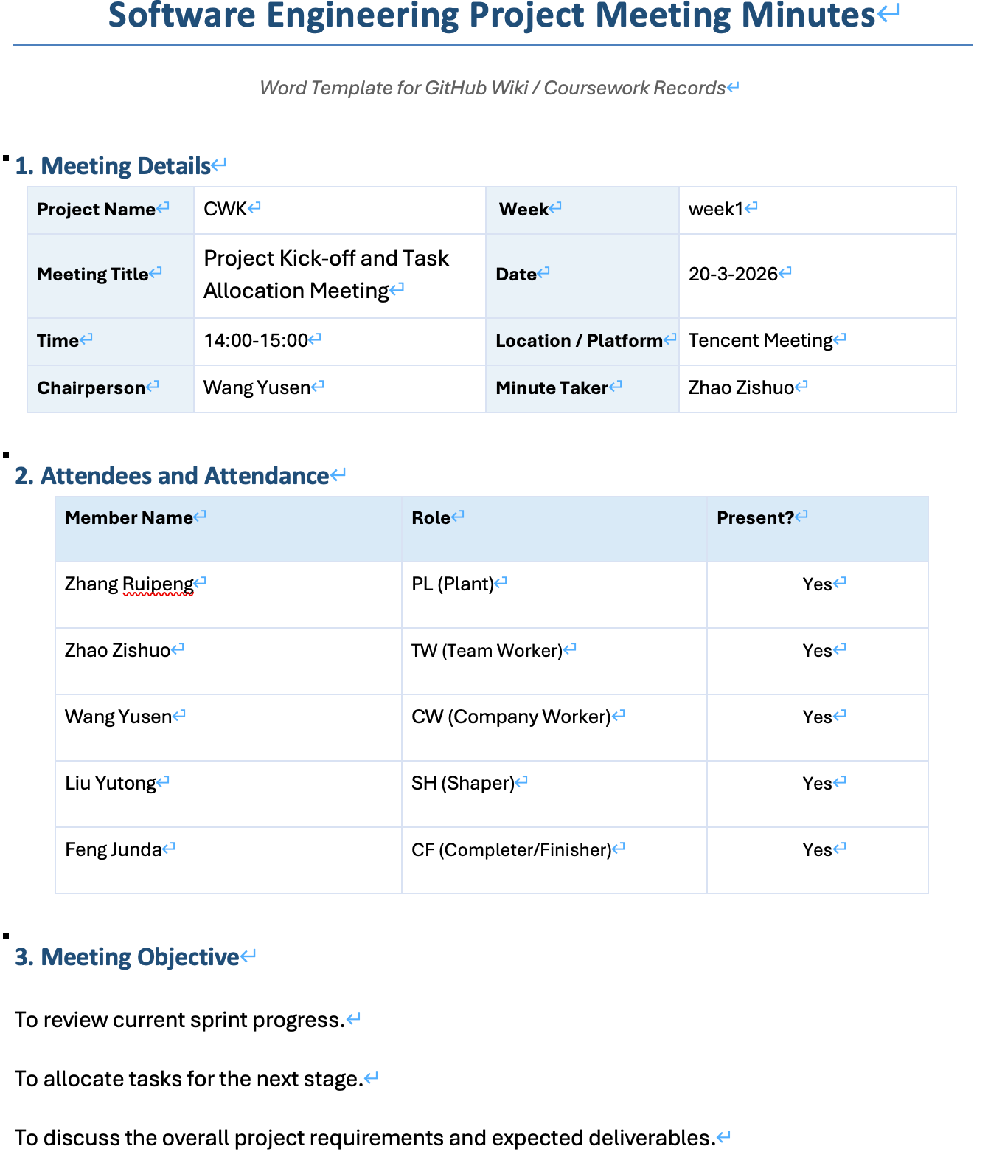
Team Management-Meeting Minutes

Slide 8
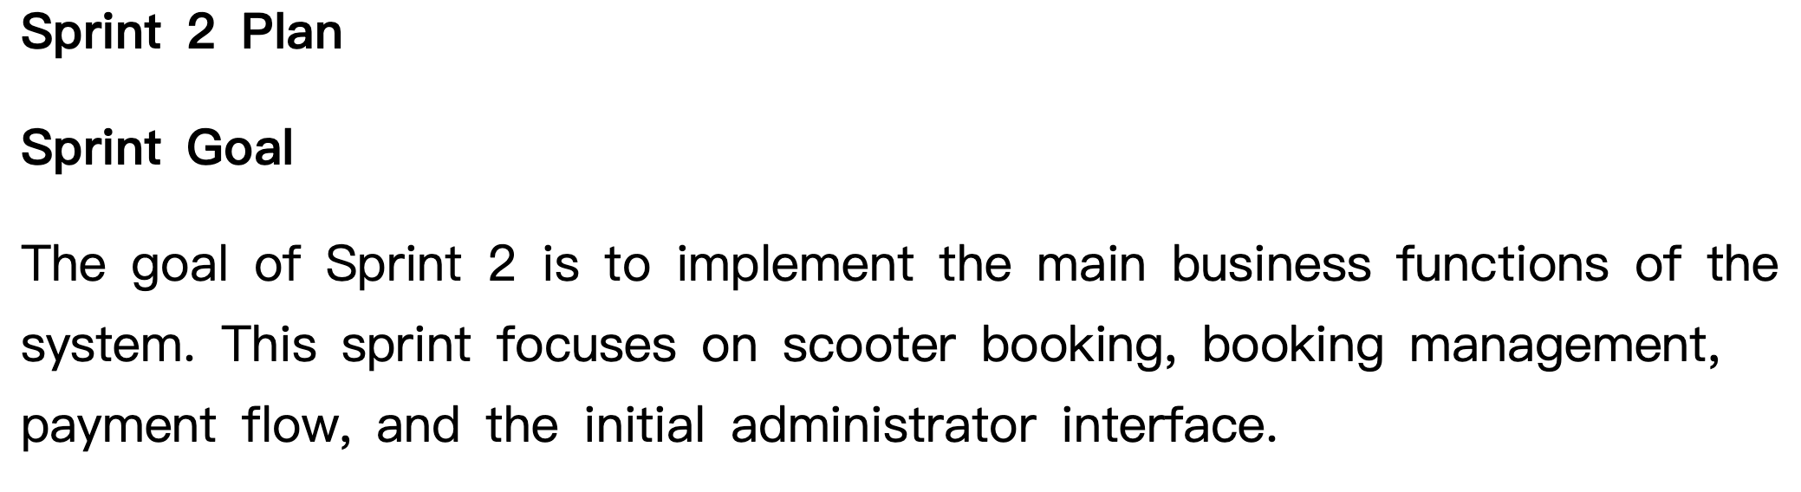
Next Sprint Plan
Focus areas for Sprint 2
Implement booking, save booking records, and add booking history
Add booking cancellation, booking extension, and payment flow
Create booking details page and develop the admin dashboard
Implement viewing of user records and booking records
Update the backlog and Sprint 2 review notes

